Slide 1
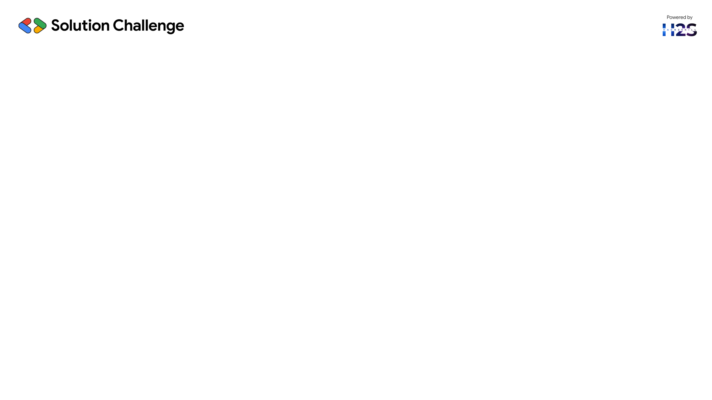
Guidelines
Kindly use the given template for submitting your project (Make a copy of the template)
One team is only required to submit one project.
The ideal size of the presentation should not be more than 10 slides.
You are welcome to add as many POCs and design concepts to support your project.
The project should be feasible and the team members should be capable enough, to come up with the prototype of the same idea, if required.
Projects using Google developer technologies like Gemini APIs & building projects on IDX platform will earn additional points.
In case of queries, kindly reach out to us at solutionchallengesupport@hack2skill.com

Slide 2
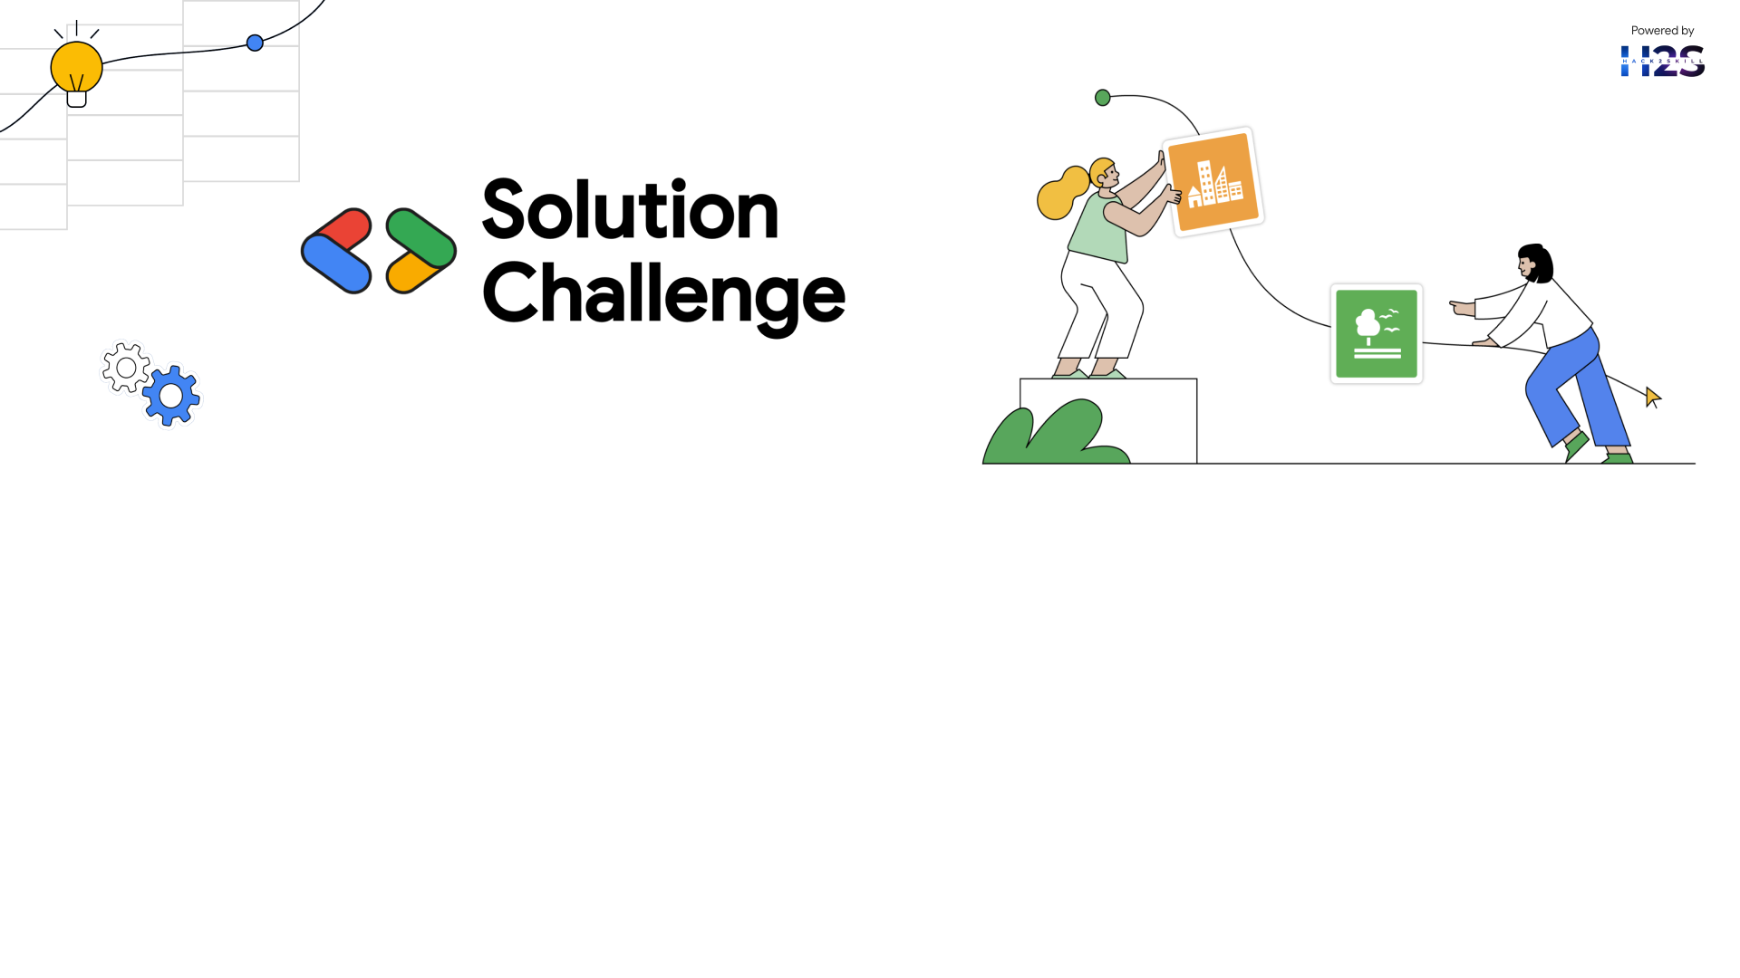
Team Details
Team name: ECE DAZZLERS
Team leader name:KRITHIK GOKUL S
Problem Statement: QUALITY EDUCATION

Slide 3
Brief about your solution:-
EduBridge is a machine learning-powered web app that uses adaptive learning, performance analytics, and inclusive resources to provide equitable learning opportunities.

Slide 4
Opportunities
How different is it from other ideas?
- Uses ML for personalization
- Multilingual and accessibility features
- Gemini API for smart explanations
How will it solve the problem?
- Adaptive content based on performance
- Inclusive access for underprivileged students
USP:
- AI-driven feedback and smart summaries

Slide 5
List of features offered by the solution
- Personalized learning paths
- Real-time performance feedback
- Multilingual support
- Voice-to-text and text-to-speech
- Smart content via Gemini API

Slide 6
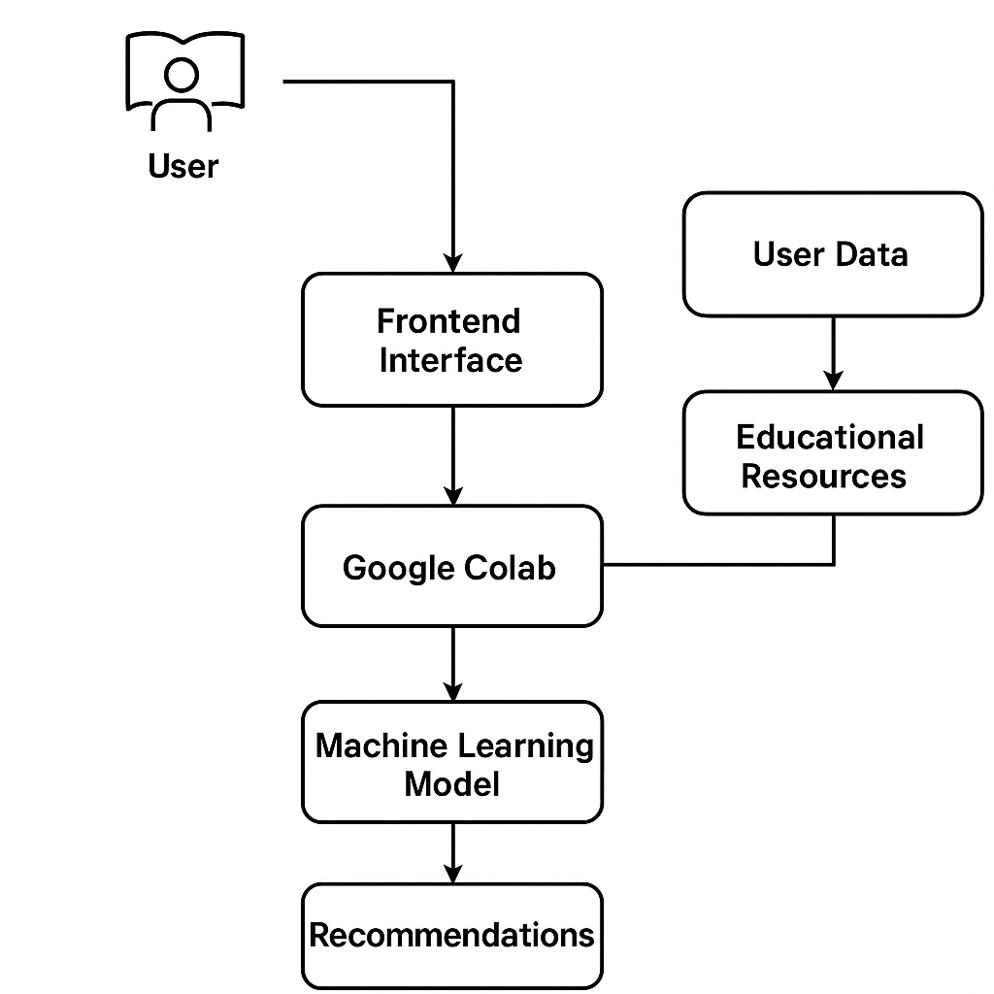
Process flow diagram or Use-case diagram:-
Block Diagram:
1. User Input
2. ML Model in Colab
3. Personalized Plan
4. Feedback Loop
5. Adaptive Recommendation

Slide 7
Wireframes/Mock diagrams of the proposed solution (optional)
Technologies:
Streamlit Frontend Example:
Python Code:-
import streamlit as st
name = st.text_input("Name")
subject = st.selectbox("Subject", ["Math", "Science"])
if st.button("Get Plan"):
st.success(f"Your plan is ready, {name}!")

Slide 8
Architecture diagram of the proposed solution
Technologies:
- Google Colab (ML model)
- Streamlit (Frontend)
- Gemini API (Smart content)
- Firebase (User data)
- Python, HTML/CSS

Slide 9
Snapshots of MVP
MVP Description:
- User input on Streamlit UI
- Google Colab generates learning path
- Firebase stores user progress
- Gemini API gives explanations

Slide 10
Future Development
- Offline support for rural areas
- AR/VR-based modules
- NLP for doubt-solving
- Global educational collaborations

Slide 11
References
- UNESCO SDG4 Report
- Google Gemini API Docs
- Streamlit Docs
- Research Papers on AI in Education

Slide 12
Provide links to your:
GitHub Public Repository:https://github.com/krithikgokuls/Quality-Education
Demo Video Link (3 Minutes):-https://www.youtube.com/watch?v=_kZVMsMt86o
MVP Link:Preparation is going

Slide 13
